Slide 1
Single cell RNA sequencing
Åsa Björklund
asa.bjorklund@scilifelab.se

Slide 2
Outline
Why single cell transcriptomics?
Experimental setup
Computational analysis
Examples of scRNA-seq experiments

Slide 3
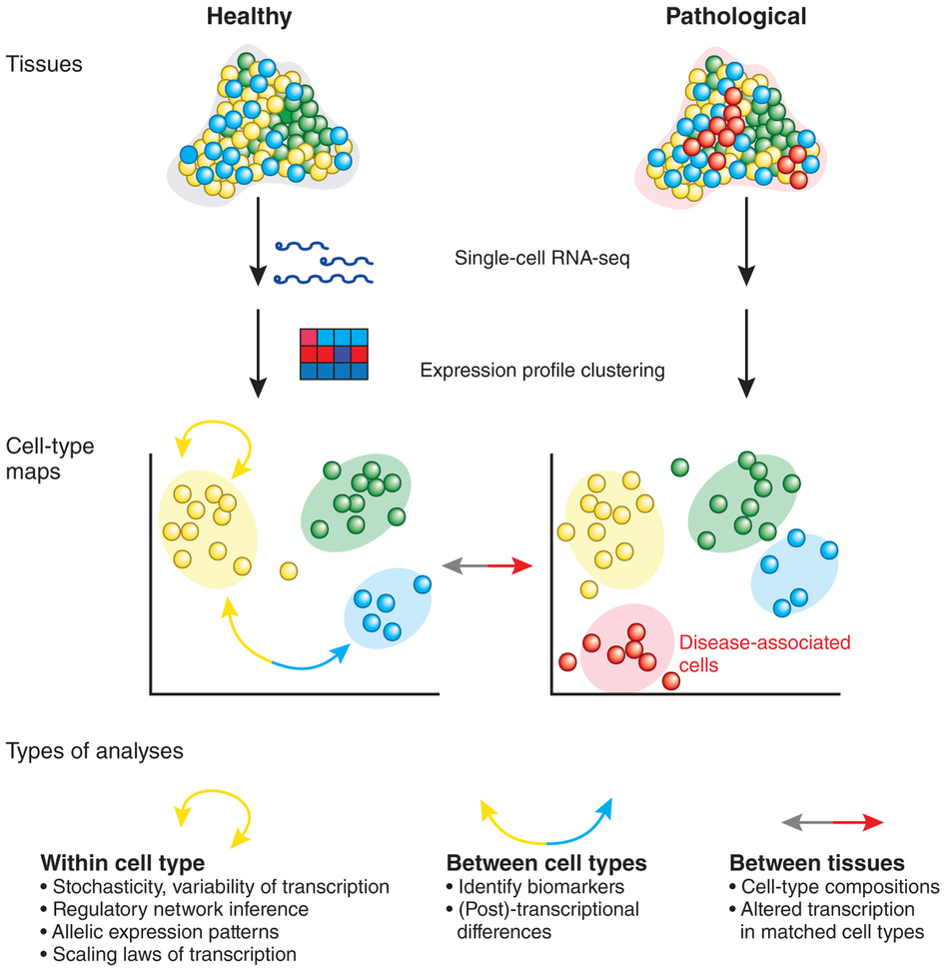
(Sandberg, Nature Methods 2014)

Slide 4
Why single-cell transcriptomics?
Understanding heterogeneous tissues
Identification and analysis of rare cell types
Changes in cellular composition
Dissection of temporal changes
Example of applications:
Differentiation trajectories
Cancer heterogeneity
Neural cell classification
Embryonic development
Drug treatment response

Slide 5
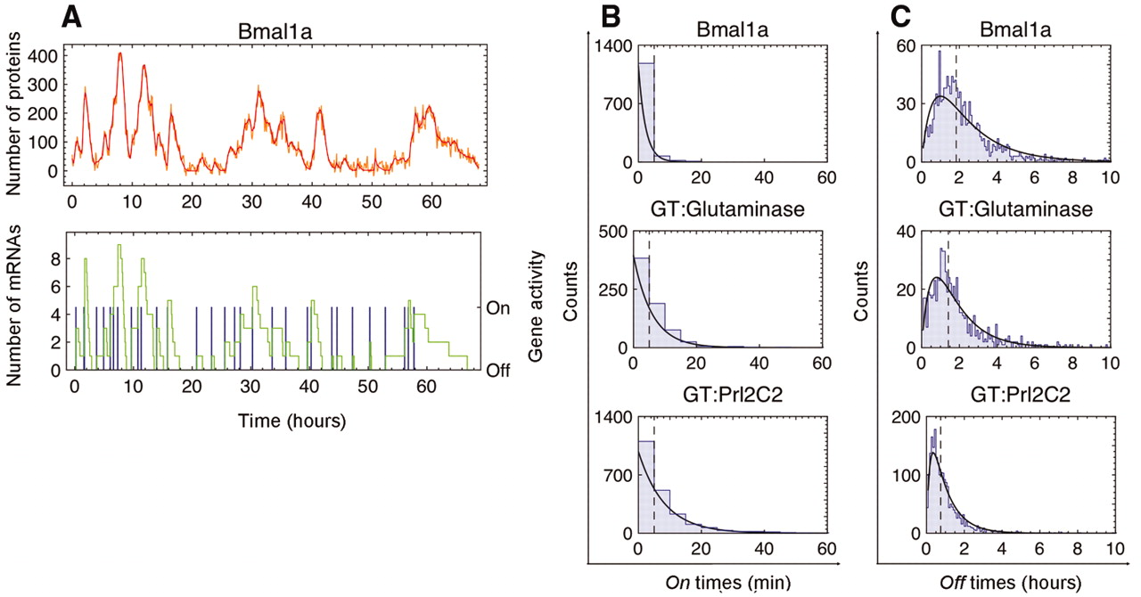
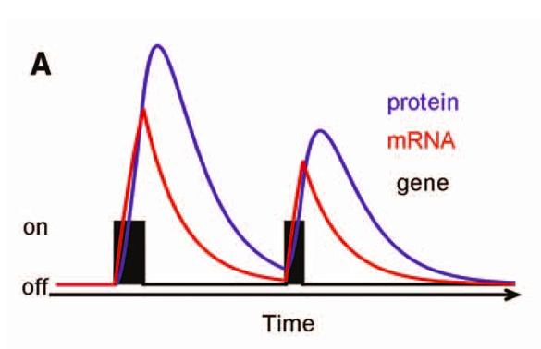
Transcriptional bursting
Burst frequency and size is correlated with mRNA abundance
Many TFs have low mean expression (and low burst frequency) and will only be detected in a fraction of the cells
(Suter et al. Science 2011)

Slide 6
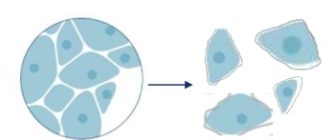
Experimental setup
Cell dissociation
Single cell capture
Single cell lysis
Tissues can be dissolved with mechanical methods, detergents or enzymatic digestion.
It is critical to have healthy whole cells with no RNA leakage.
Should minimize time from dissociation to cell capture to reduce effect on transcriptional state.
Depending on your tissue type you may need to select different protocols.
Reverse transcription
Preamplification
Library preparation and sequencing
(Kolodziejczyk et al. 2015)

Slide 7
Experimental setup
Cell dissociation
Single cell capture
Single cell lysis
Reverse transcription
Preamplification
Tissues that are hard to dissociate:
Laser capture microscopy (LCM)
Nuclei sorting
Library preparation and sequencing
(Kolodziejczyk et al. 2015)

Slide 8
Experimental setup
Cell dissociation
Single cell capture
Single cell lysis
Reverse transcription
Preamplification
Efficiency of reverse transcription is the key to high sensitivity. Drop-out rate is around 90-60% depending on the method used.
Library preparation and sequencing
(Kolodziejczyk et al. 2015)

Slide 9
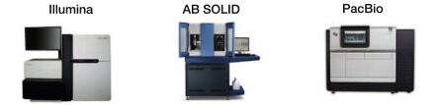
Experimental setup
Cell dissociation
Single cell capture
Single cell lysis
Reverse transcription
Preamplification
Library preparation and sequencing
(Kolodziejczyk et al. 2015)

Slide 10
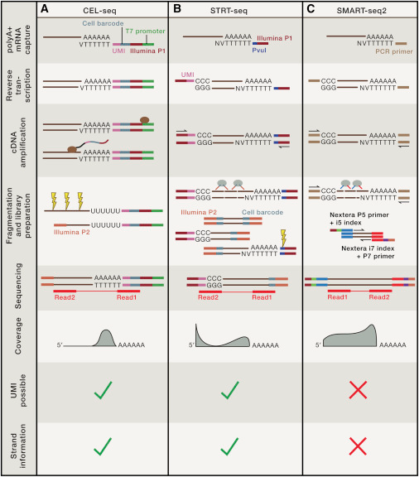
Overview of the 3 common library preparation methods
(Grun et al. Cell 2015)

Slide 11
Small volume approaches
Volume seem to be a key component in these reactions
Smaller volumes give better detection and reproducibility
Smaller volumes = cheaper reagent costs
Methods for high throughput (1000nds of cells)
Sequencing cost becomes the bottleneck instead – often shallow sequencing

Slide 12
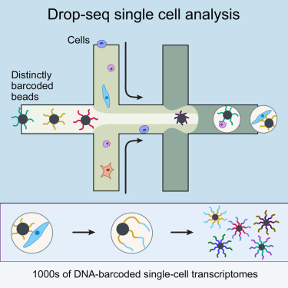
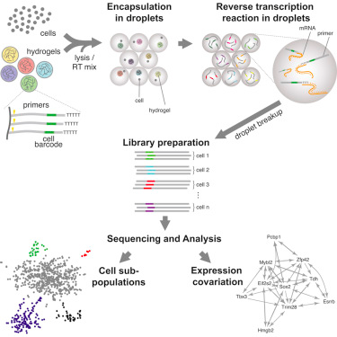
Droplet / microfluidics approaches
Macosko et al. Cell 2015
McCarrol, Regev etc. Broad/Harvard
Klein et al. Cell 2015
Kirschner, Weitz etc. Harvard

Slide 13
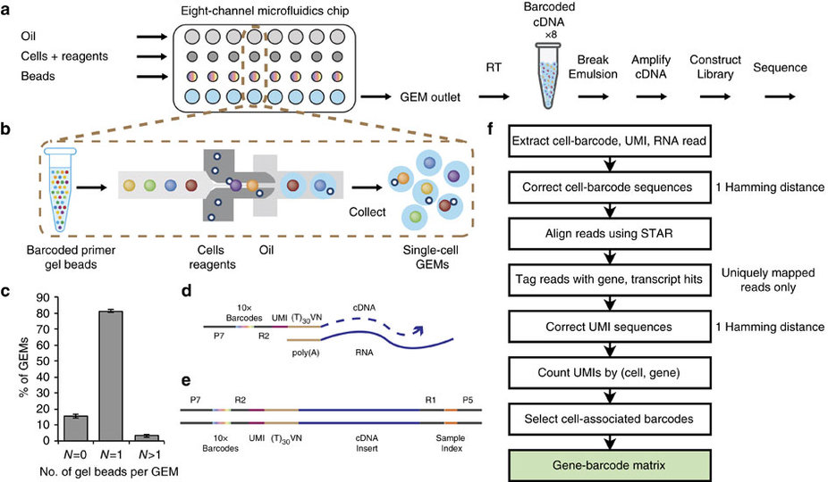
Chromium 10X Genomics
Droplet based system for scRNAseq and genome sequencing
500-10,000 single cells
CellRanger sofware for analysis of results
(GXY Zhang et al Nat Communications 2017)

Slide 14
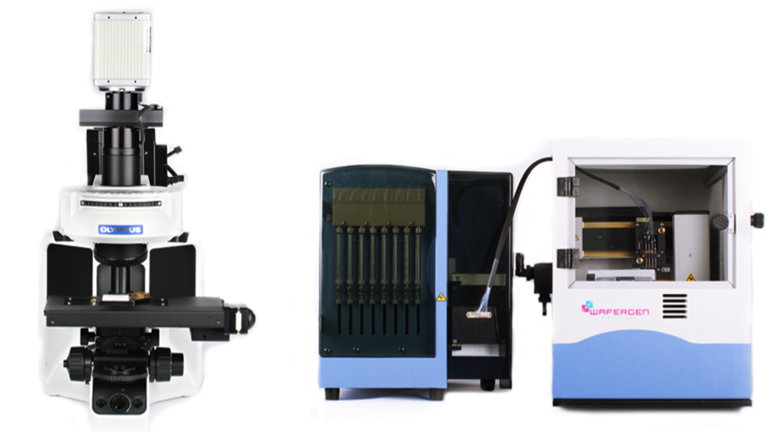
Wafergen ICELL8 microwell system
ICELL8 chip with 9600 wells
Multi sample nano dispenser
Can use FACS sorting
Imaging station
Software to select cells -> minimize number of doublets
Possible to save images of cells with a few different colors
Implemented with STRT at the ESCG platform

Slide 15
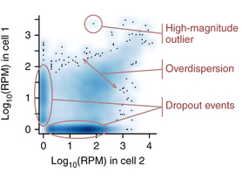
Problems compared to bulk RNA-seq
Amplification bias
Drop-out rates
Transcriptional bursting
Background noise
Bias due to cell-cycle, cell size and other factors
(Karchenko et al. Nature Methods 2014)

Slide 16
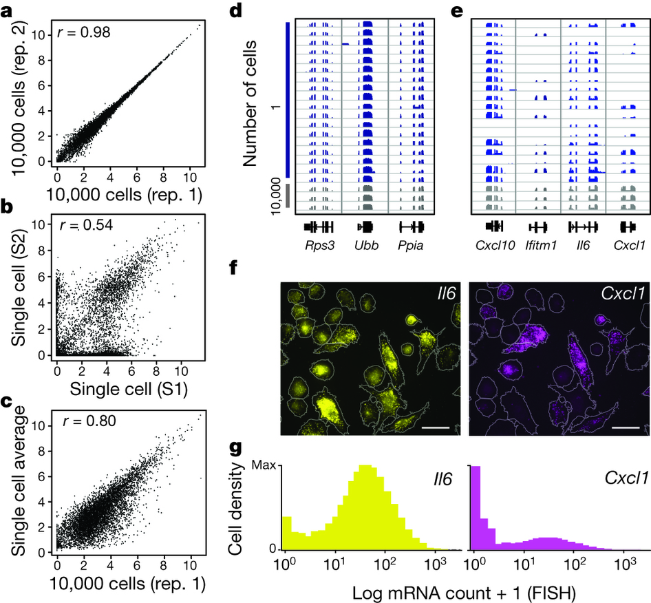
Example data - mouse bone-marrow-derived dendritic cells (BMDCs)
(Shalek et al. Nature 2013)

Slide 17
Unique molecular identifiers (UMIs) and cellular barcodes
Cellular barcodes
Introduced at RT step with one unique sequence per cell
Enables pooling of many libraries into one tube for subsequent steps
UMIs
Introduce random sequences at the beginning of each sequence
Reduces effect of amplification bias by removing PCR duplicates
Implemented with tag-based methods such as STRT and CEL-seq

Slide 18
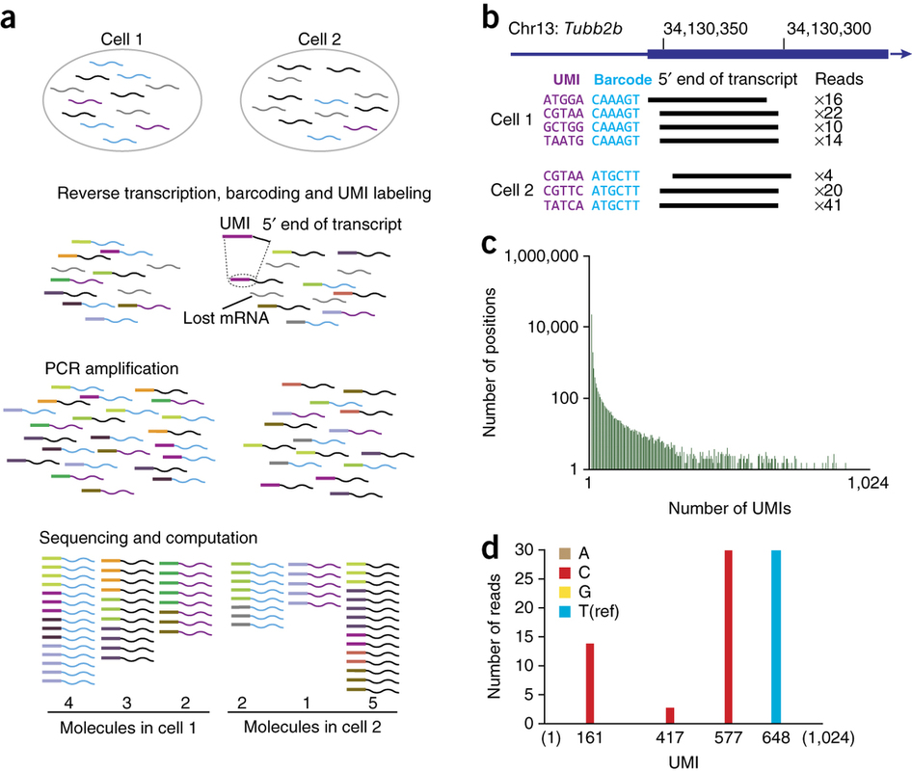
Unique molecular identifiers (UMIs) and cellular barcodes
(Islam et al. Nature Methods 2014)

Slide 19
Spike-in RNAs
Addition of external controls
Used to model:
technical noise / drop-out rates
starting amount of RNA in the cell
ERCC spike-in most widely used, consists of 48 or 96 mRNAs at 17 different concentrations.
Important to add equal amounts to each cell, preferably in the lysis buffer.

Slide 20
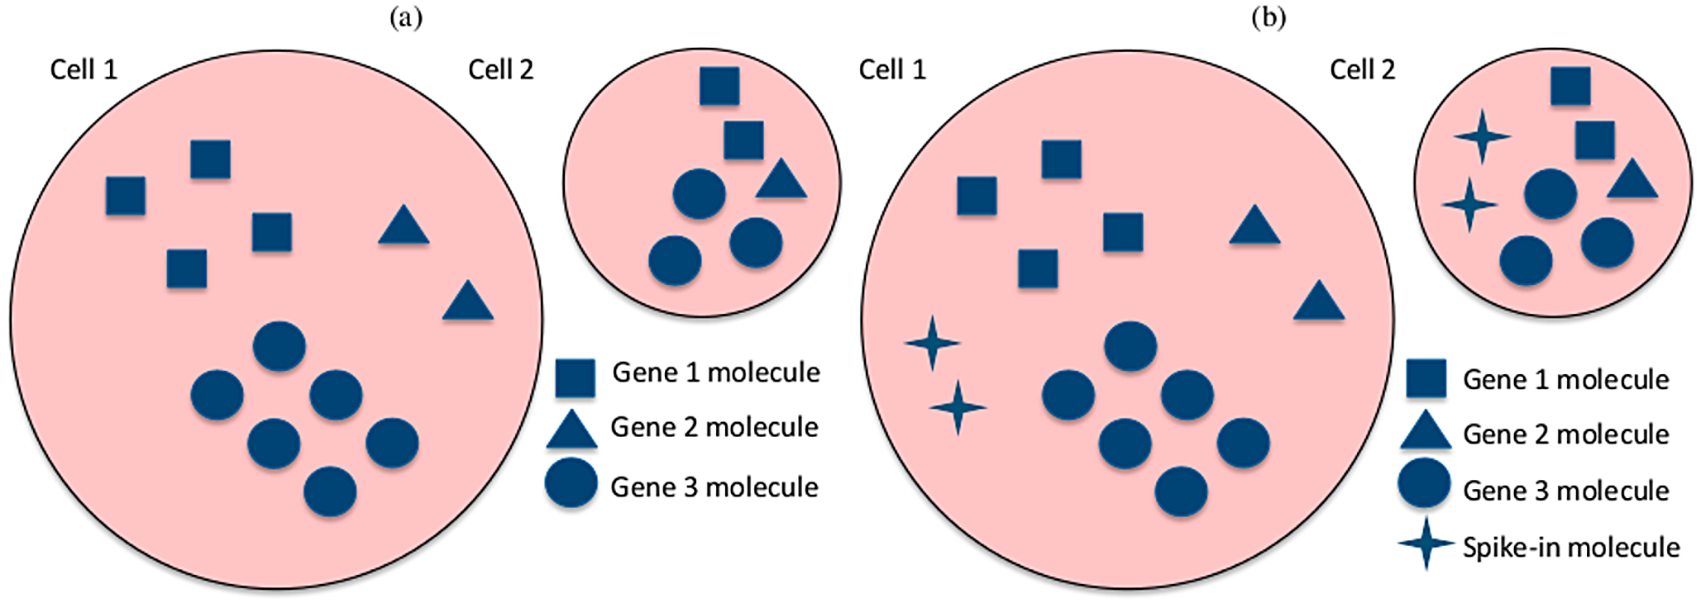
Spike-in RNAs
(Vallejos et al. PLOS Comp Biol 2015)

Slide 21
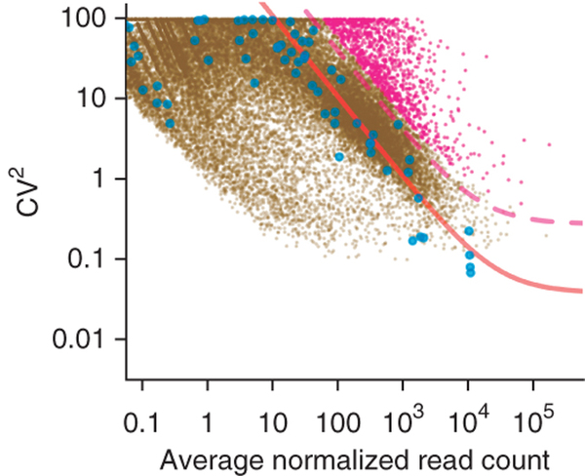
Spike-in RNAs Finding biologically variable genes
(Brennecke et al. Nature Methods 2013)

Slide 22
Replicates – how many cells do you have to sequence?
Recommended to have at least 20-30 cells from each cell type
A sample with a minor cell type at 5% requires sequencing of 400 cells.
Preselecting cells may be necessary, but unbiased cell picking is preferred.
Depending on the sensitivity of your method you may need more/less cells
To study gene expression only, sequencing depth does not have to be deep.
Multiplexing of hundreds of samples on one lane is common.
For tag-based methods sequencing is often more shallow.
Possible to have a consultancy session with someone at NBIS for experimental design.

Slide 23
Which method should I use?
Full length (SmartSeq2) vs tag-based (CELseq/STRT) methods:
Trade-off between throughput and sensitivity
Unique molecular identifiers (UMI) implementation with the tag-based methods
Practical issues such as sorting of cells

Slide 24
National single cell genomics platform at Scilifelab
Uppsala node – Microbial single cell genomics
http://www.scilifelab.se/facilities/single-cell/
MDA of whole genomes
qPCR of selected target genes
Stockholm node – Eukaryotic single cell genomics (ESCG)
http://www.escg.se
Several technologies for scRNA-seq
MDA whole genome sequencing

Slide 25

RNA-seq services at ESCG
 | Full-length | Quantitative
 | Smart-seq2 | STRT-C1 | STRT-Wafergen | 10xGenomics
Format | Eppendorf Twin-tek | C1 microfluidics chip (Fluidigm) | Microwell chip | Chromium microfluidics chip
Cell number | 384 | 3 x 96 | 9,600 (~2,500) | 8 x 500-10,000
Input | FACS-sorted cells | Cell suspension | Cell suspension | Cell suspension
Transcript coverage | Full-length | 5’ | 5’ | 3’
Advantage | Flexible delivery SNPs, mutations Nuclei | Imaging Cell selection | Unbiased Cell selection 8 samples parallel Nuclei | High throughput 8 samples parallel Sample pooling
Limitation | No UMI (ERCC) | Low throughput Cell size bias | Limiting dilution Challenging FACS sort | Potential clogs
(From Karolina Wallenborg at ESCG)

Slide 26
User fees
Smart-seq2 384 well plate | STRT-C1 96 cell chip (50-96 cells) | STRT-Wafergen 9600 wells chip (~2,500 cells) | 10XGenomics 1 sample (~3,000 cells)
Validation Smart-seq2 library Sequencing (50 bp, single-read | Validation STRT-C1 library Sequencing (50bp single-read) | Validation STRT library (dual index) Sequencing (50 bp single-read) | Validation Illumina library Sequencing (paired-end, dual index)
~40,500 SEK | ~22,500 SEK | ~45,000-50,000 SEK | ~43,000 SEK
Costs include: Reagents, consumables, instrument depreciation, instrument service, personnel. Overhead is not included.
(From Karolina Wallenborg at ESCG)

Slide 27
scRNA-seq analysis overview
Raw data –
fastq files
Same as bulk RNAseq (with spike-ins)
Mapping
Gene expression estimate
Data normalization
Gene set selection
Batch effect removal
Removal of other confounders
QC:
Remove low Q cells
Remove contaminants
Data:
expression profiles
Defining cell types/lineages
Dimensionality reduction
Clustering methods
Pseudotime assignment
Gene signatures
Verification experiments

Slide 28
Quality Control (QC)
QC is a crucial step in scRNA-seq - Any experiment will have a number of failed libraries!
OBS! Smaller celltypes gives lower mapping rates and more primer dimers.
Can look at:
Mapping statistics (% uniquely mapping)
Mismatch rate
Fraction of exon mapping reads
3’ bias (degraded RNA)
mRNA-mapping reads
Number of detected genes
Spike-in detection
Mitochondrial read fraction
Pairwise correlation to other cells
Depending on cell type, around 500K exon mapping reads saturates the gene detection (deduced from subsampling in SS2 data).

Slide 29
Data bias
Often need to do data transformation before clustering/PCA
Normalize by spike-in RNAs
Normalize by total counts
Length normalized RPKM/FPKM
Remove cell-cycle effects, size bias or similar (scLVM package, SCDE package)
RT efficiency / drop-out rate (SCDE package, scran package)
Technical noise (BASiCS package, GRM)
Batch effect removal (SVA ComBat function, SCDE package)

Slide 30
Batch normalization with SVA function ComBat
Color by
celltype
Color by
donor
(Björklund et al. Nature Immunology 2016)

Slide 31
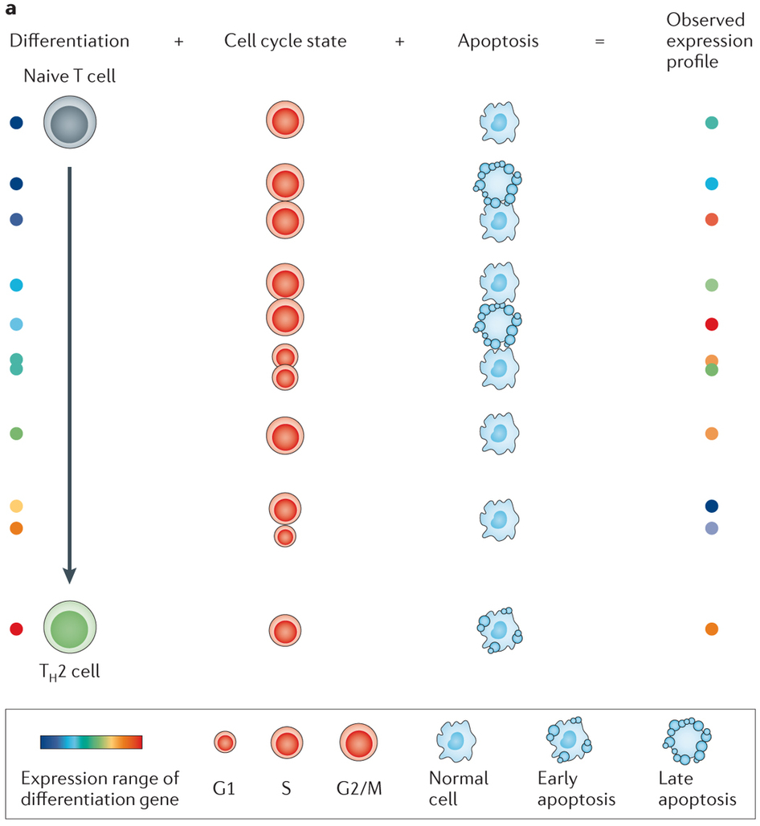
scLVM - Marioni lab https://github.com/PMBio/scLVM)
(Stegle et al. Nat Rev Genetics 2015)

Slide 32
Feature selection – subset of genes
In most cases, all genes are not used in PCA/clustering.
Gene set selection based on:
Biologically variable genes (Brenneke method based on spike-in data) or top variable genes if no spike-in data.
Genes expressed in X cells.
Filter out genes with correlation to few other genes
Prior knowledge / annotation
DE genes from bulk experiments
Top PCA loadings

Slide 33
Identifying celltypes – Dimensionality reduction
Linear methods:
PCA (principal component analysis)
ICA (independent component analysis)
MDS (multidimensional scaling)
Non-linear methods:
Non-linear PCA
t-SNE (t-distributed stochastic neighbor embedding)
Diffusion maps
Network based methods
A PCA is a very good start in getting to know your data and understanding biases, batch effects etc.

Slide 34
t-SNE vs PCA dimensionality reduction
(Björklund et al. Nature Immunology 2016)

Slide 35
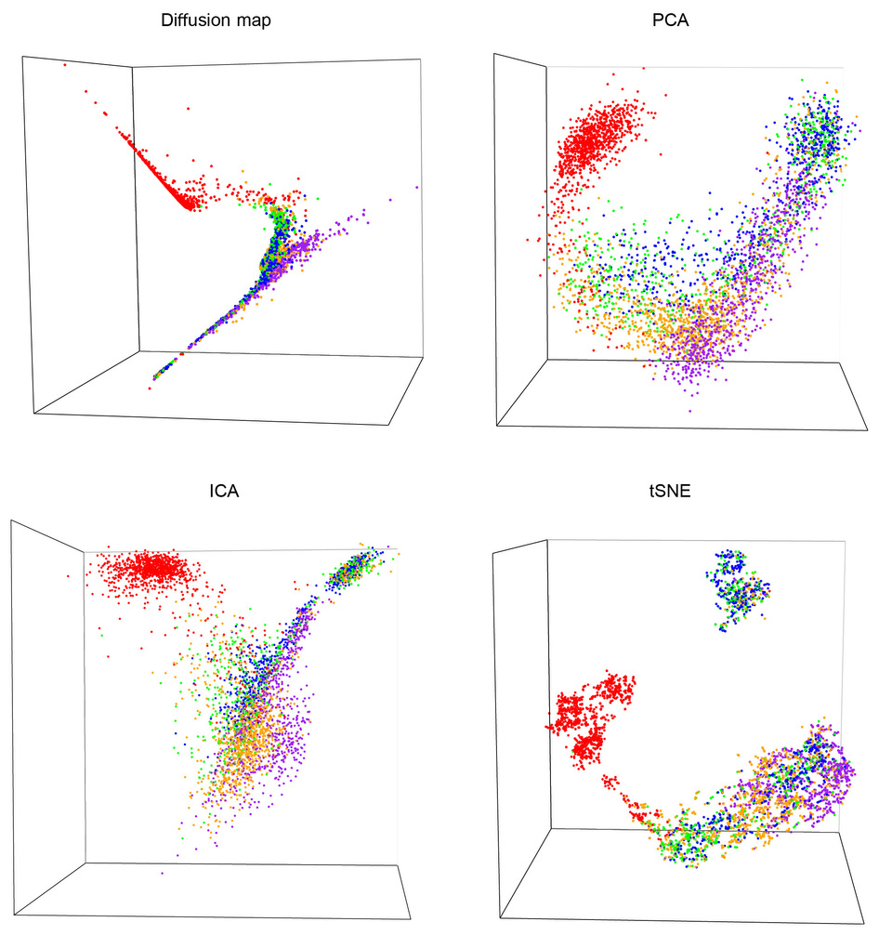
More dimensionality reductions
(Moignard et al. Nature Biotech 2015)

Slide 36
Identifying celltypes - Clustering
Clustering based on
rpkms/counts – Euklidean distances
Pairwise correlations
PCA or other dimensionality reduction method
Method of choice: hierarchical, k-means, biclustering
Some programs:
WGCNA
BackSPIN
Pagoda
DBscan
OBS! Outlier removal as an initial step may be necessary, especially with PCA-based clustering or similar.

Slide 37
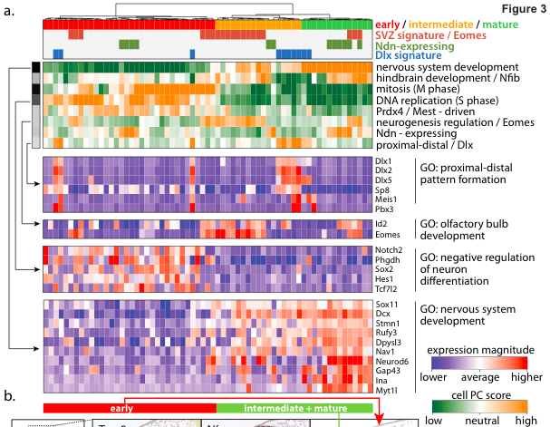
Pagoda – Pathway And Geneset OverDispersion Analysis
(Fan et al. Nature Methods 2016)

Slide 38
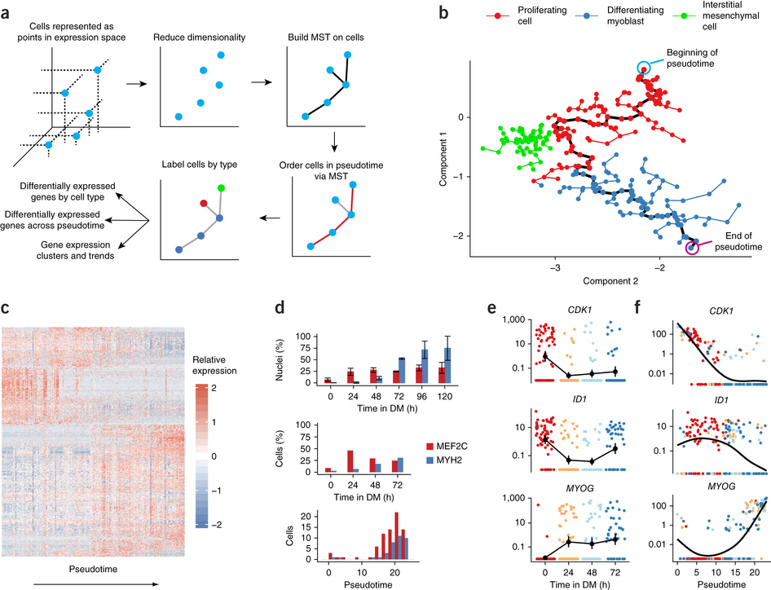
Pseudotime ordering - Monocle The dynamics and regulators of cell fate decisions are revealed by pseudotemporal ordering of single cells.
(Trapnell et al. Nature Biotech 2014)

Slide 39
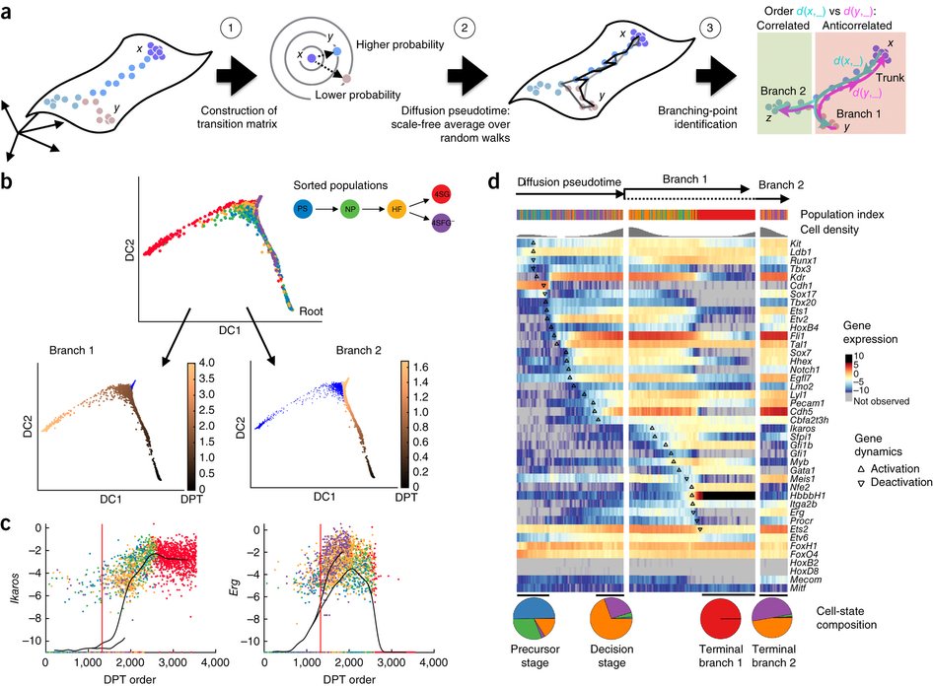
Diffusion pseudotime Diffusion pseudotime robustly reconstructs lineage branching
(Haghvedi et al Nature Methods 2016)

Slide 40
Detecting differentially expressed genes
Parametric methods like EdgeR & DESeq not suitable for scRNAseq since the parameter assumptions in those methods does not apply here.
Can use non-parametric methods like SAMseq

Slide 41
Detecting differentially expressed genes
Available single cell DE methods:
SingleCellAssay – developed for qPCR experiments
Monocle package
Single Cell Differential Expression - SCDE
Model-based Analysis of Single-cell Transcriptomics – MAST
SAMstrt – extention to SAMseq with spike-in normalization
Many other recent publications…….
Some studies use PCA contribution (loadings) or gene clustering to define celltype specific genes with no statistical DE test at all.

Slide 42
Comparison of DE detection methods
Number of DE genes between 2 celltypes using SAMseq, Single Cell Assay, SCDE, DESeq2
and Monocle. Numbers along diagonal are total number of genes, boxes on each side
shows overlap between methods.

Slide 43
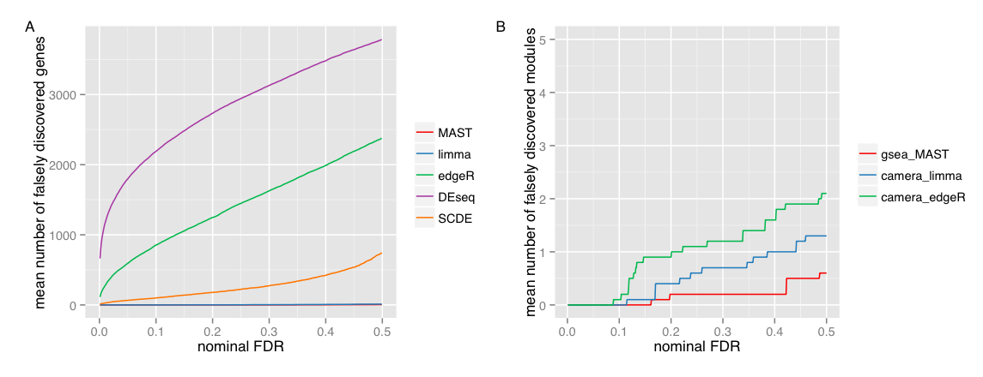
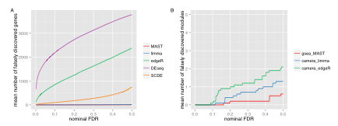
High false discovery rate for DESeq and EdgeR
Detected DE genes and gene sets using randomly permuted cells from unstimulated MAIT cells
(Finak et al. Genome Biology 2015,
Supplementary material)

Slide 44
scRNA-seq analysis overview
Raw data –
fastq files
Same as bulk RNAseq (with spike-ins)
Mapping
Gene expression estimate
Data normalization
Gene set selection
Batch effect removal
Removal of other confounders
QC:
Remove low Q cells
Remove contaminants
Data:
expression profiles
Defining cell types/lineages
Dimensionality reduction
Clustering methods
Pseudotime assignment
Gene signatures
Verification experiments

Slide 45
Additional analyses
Allelic expression
Variant calling
Copy-number variation
Alternative splicing
Alternative splicing and allelic expression requires full length methods.
But only works for highly expressed genes with good read coverage
Must be careful to take into consideration the drop-out rate, a unique splice form/allele in a single cell may actually be a detection issue.

Slide 46
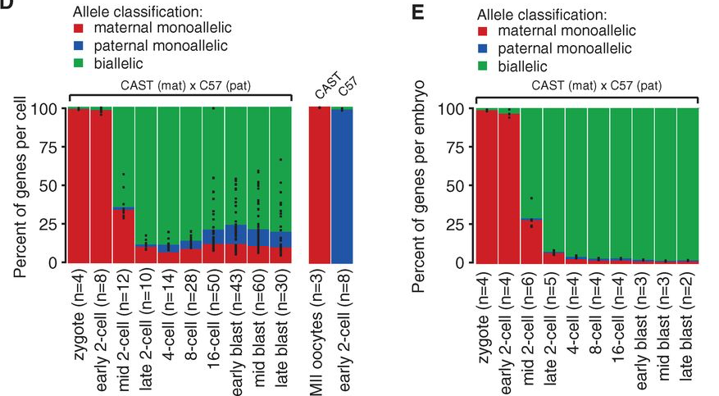
Single-Cell RNA-Seq Reveals Dynamic, Random Monoallelic Gene Expression in Mammalian Cells
Single cells Pooled embryos
(Deng et al. Science 2014)

Slide 47
Using Single Nucleotide Variations in Cancer Single-Cell RNA- Seq Data for Subpopulation Identification and Genotype- phenotype Linkage Analysis
(Poiron et al. BioRxiv 2016)

Slide 48
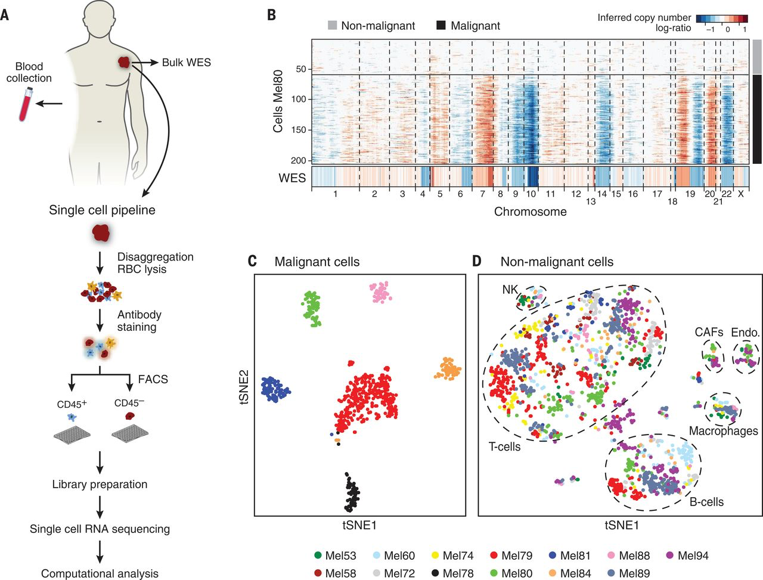
Dissecting the multicellular ecosystem of metastatic melanoma by single-cell RNA-seq
(Tirosh et al. Science 2016)

Slide 49
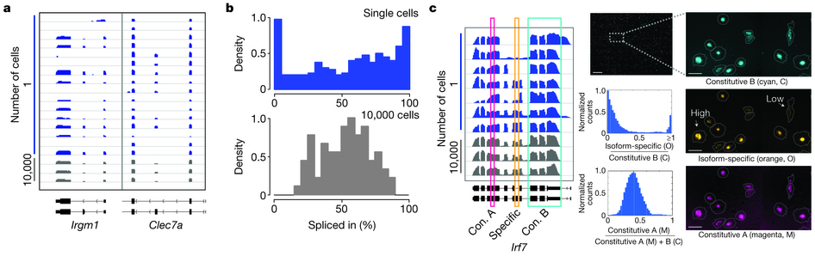
Cell specific alternative splicing
(Shalek et al. Nature 2013)

Slide 50
Combination with single cell genome sequencing
G&T-seq (Macaulay et al. Nature Methods 2015) – DNA + RNA
DR-seq (Dey et al. Nature Biotech 2015) – DNA + RNA
scTrio-seq (Hou et al. Cell Research 2016) - RNA + DNA & DNA methylome
scM&T-seq (Angermueller Nature Methods 2016) – RNA + DNA methylome

Slide 51
Non coding RNA single cell library
SUPeR-seq – random hexamer primer instead of polyA-priming (Fan et al. Genome Biology 2015)
Detect circular RNAs and other non-coding RNAs as well as mRNAs
small RNA library prep from single cells (Faridani et al. Nature Biotech 2016)
Ligate adapters to 5′ phosphate and 3′ hydroxyl groups
Detect miRNA, snoRNA etc.

Slide 52
Conclusions
For diverse cell-types often straight forward to group cells into clusters and detect differentially expressed genes.
For highly similar subtypes or with subtle changes in cellular states – feature selection and different clustering methods may be required.
PCA or other dimensionality reduction technique is a good start to get to know your data.

Slide 53
Some tools for single cell analysis
Tutorial from Harvard WS:
http://pklab.med.harvard.edu/scw2015/
For differential expression:
SCDE: http://pklab.med.harvard.edu/scde/index.html
SCA: https://github.com/RGLab/SingleCellAssay
MAST: https://github.com/RGLab/MAST
SAMseq: http://cran.r-project.org/web/packages/samr
For clustering, normalization etc.:
Monocle2/Census: https://github.com/cole-trapnell-lab/monocle-release
Rtsne: http://cran.r-project.org/web/packages/Rtsne
Sincell: http://master.bioconductor.org/packages/devel/bioc/html/sincell.html
scLVM: https://github.com/PMBio/scLVM
BASiCS: https://github.com/catavallejos/BASiCS
Pagoda: http://pklab.med.harvard.edu/scde
Seurat toolkit: http://www.satijalab.org/seurat.html
Sincera pipeline: https://research.cchmc.org/pbge/sincera.html
SimpleSingleCell pipeline: https://www.bioconductor.org/help/workflows/simpleSingleCell/

